Slide 1


Android Application Development
Lecture 1(A): Before Getting Started
1. Introduction to Mobile Platforms
2. Comparison among Platforms
3. Advantages of Android Platform
4. Android Ecosystem
5. Mobile Apps Trends
6. Resources
Ahsanul Karim
karim.ahsanul@gmail.com
http://droidtraining.wordpress.com

Slide 2
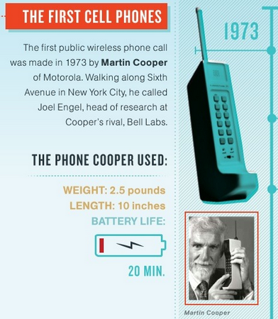
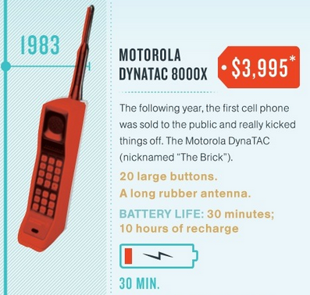
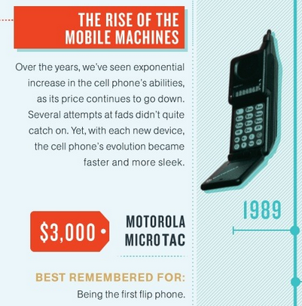
Introduction to Mobile Platforms
A Brief History [1]
April 3, 2013: 40th anniversary of first cell phone call ever made
1973
1983
1989

Slide 3
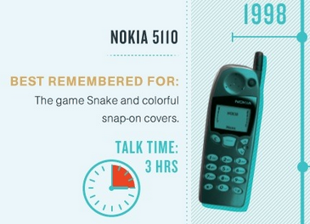
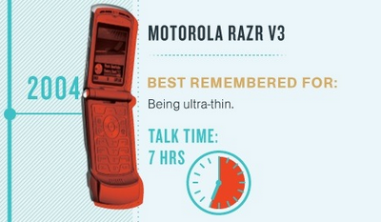
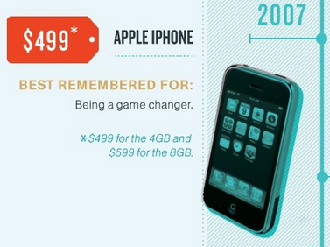
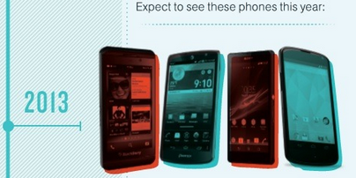
Introduction to Mobile Platforms
A Brief History [2]
1998
2004
2013
2007
InfoGraphics Source: mashable.com

Slide 4
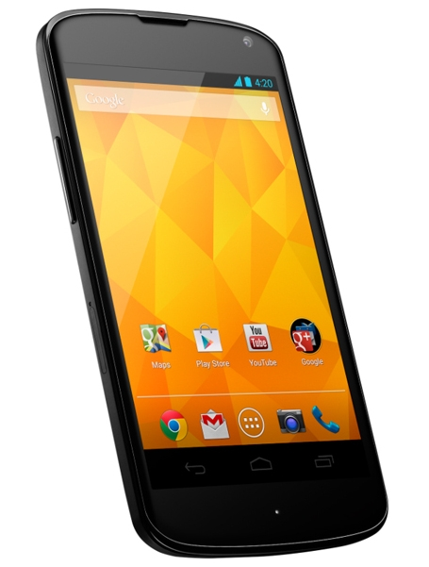
Introduction to Mobile Platforms
Smartphones [1]
A Smartphone is a mobile phone that offers:
1. Advanced Computing Ability
2. Rich Feature Set
3. Connectivity
Handheld computers with Telephony
Most of them comes with own Operating System with Application Development Frameworks.
To learn more: wikipedia on Smartphone

Slide 5
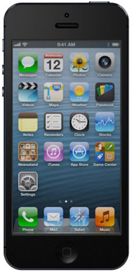
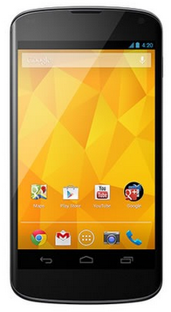
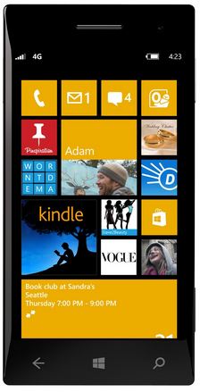
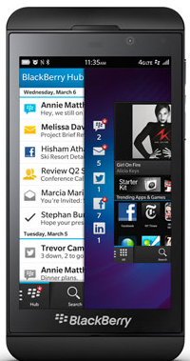
Introduction to Mobile Platforms
Smartphones [2]
Android
iPhone
Windows Phone
Blackberry
and Others...

Slide 6
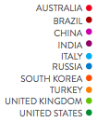
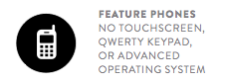
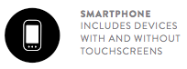
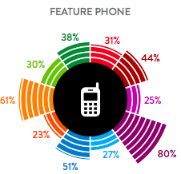
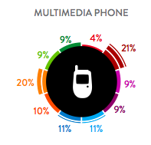
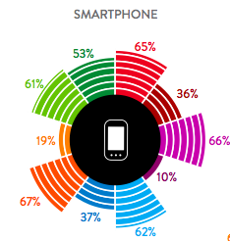
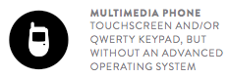
Introduction to Mobile Platforms
Smartphones [3]
What Type of Mobile Devices do we use in 2013
Data Source: Nielson's Report 2013

Slide 7
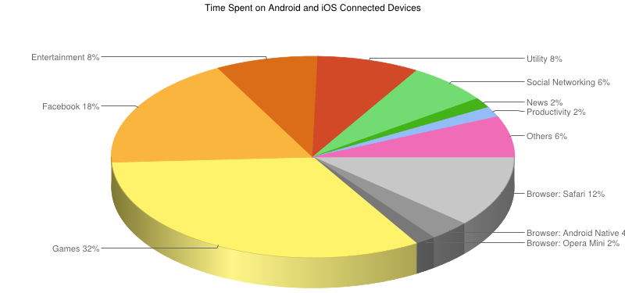
Introduction to Mobile Platforms
Phone Usage [1]
Analytics Data showing WHAT USERS DO [US Consumers only]
Data Source: Flurry.com

Slide 8
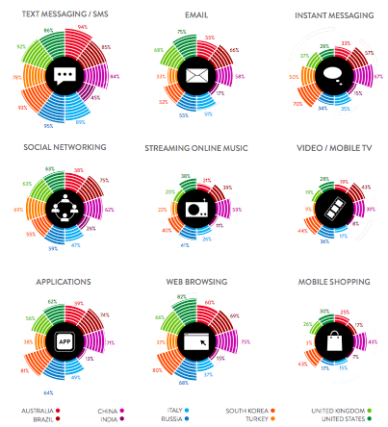
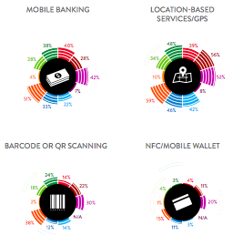
Introduction to Mobile Platforms
Phone Usage [2]
Analytics Data showing WHAT USERS DO
Data Source: Nielson's Report 2013

Slide 9
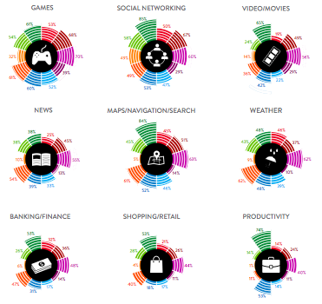
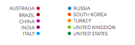
Introduction to Mobile Platforms
Phone Usage [3]
Which Apps do we use
Data Source: Nielson's Report 2013

Slide 10
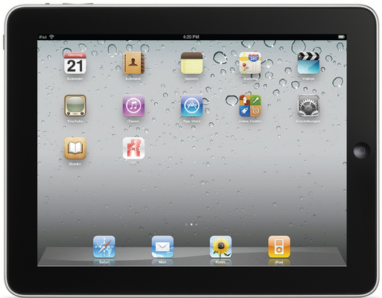
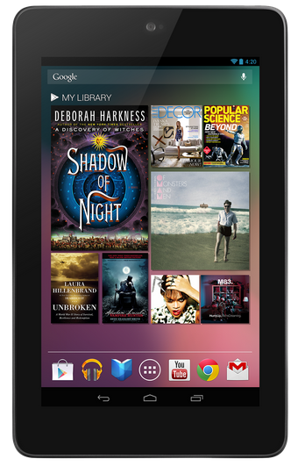
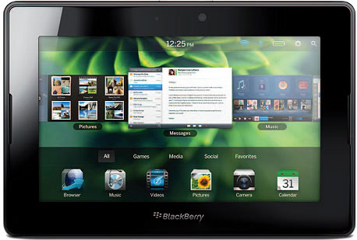
Introduction to Mobile Platforms
Tablets...
iPad
Playbook
Nexus 7

Slide 11
Introduction to Mobile Platforms
Platforms...
Platform | Language(s) | Remarks
Android | Java, C, C++ | Open Source [OS based on Linux] http://developer.android.com
Bada | C, C++ | Samsung's platform [OS running on Linux/RealTime OS] http://developer.bada.com
BlackBerry | C, C++, Java | A platform that provides a variety of development languages and runtimes http://developer.blackberry.com/
iOS | C, Objective-C | Requires Apple Developer account http://developer.apple.com/devcenter/ios/index.action
MeeGo | Qt, C++ | Intel and Nokia giuded open source OS (Based on Linux) http://meego.com/developers

Slide 12
Introduction to Mobile Platforms
Platforms...
Platform | Language(s) | Remarks
Symbian | C, C++, Java, Qt, Web Apps, Others | OS built from the ground up for mobile device http://www.forum.nokia.com/symbian
webOS | HTML, CSS, Javascript, C | Supports widget style programming (base don Linux) http://developer.palm.com
Windows Mobile | C#, C | .NET CF or Windows Mobile API, most device ship with Java ME compatible JVM http://developer.windowsmobile.com
Windows Phone/ Windows 8 | C#, VB.NET | Silverlight, XNA Framework http://create.msdn.com
Data Source: Mobile Developer's Guide to the Galaxy

Slide 13
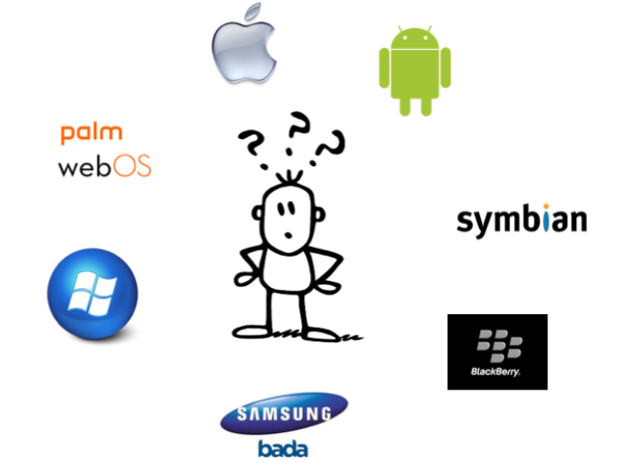
Introduction to Mobile Platforms
Platforms...

Slide 14
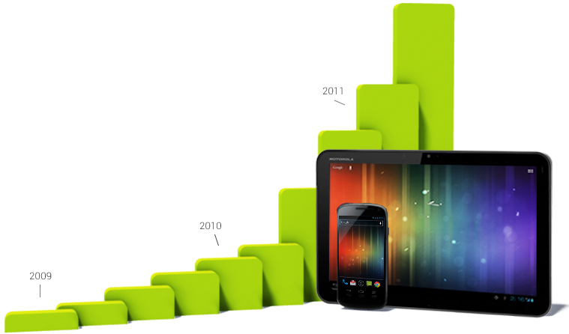
Why Android
Fastest Growth
Every day more than 1 million new Android devices activated worldwide.
[1] Android powers hundreds of millions of mobile devices in more than 190 countries around the world.
[2] It's the largest installed base
[3] Fastest Growth
Data Source: Developer Site

Slide 15
এন্ড্রয়েড এপ্লিকেশন ডেভেলপমেন্ট
Why Android
প্রতিদিন ১ মিলিয়নের বেশি এন্ড্রয়েড ডিভাইস এক্টিভেটেড হয়
সহজে এবং একই সাথে ফোন, ট্যাবলেট ও অন্যান্য ডিভাইসের জন্য এপস
প্রতি মাসে ১.৫ বিলিয়নের বেশি এপস ডাউনলোড
গুগল প্লে ছাড়াও বিভিন্ন এপ মার্কেট

Slide 16
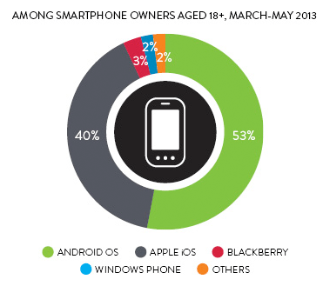
Why Android
Largest Market Share
During 3 months (March 2013-May 2013), 53% of smartphone owners in the US had a handset that runs on the Android operating system
Data Source: Neisen Newswire

Slide 17
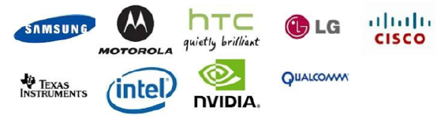

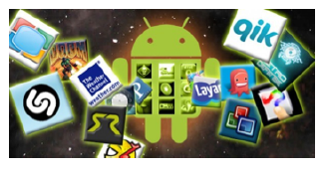

Why Android
Complete Ecosystem
Open Handset Alliance Nov, 2007
Manufacturers: Designing and Marketing Handsets
Mobile Operators
Developers: Developing Apps
App Stores: Distributing Apps

Slide 18
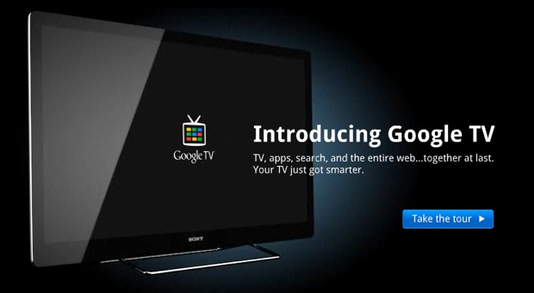
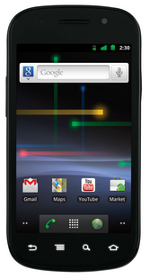
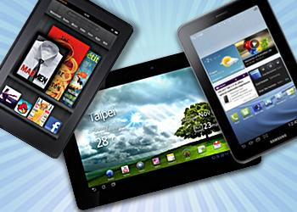
Why Android
Wide Rage of Device Support
Easily optimize a single binary for phones, tablets, and other devices.
[1] Smartphones
[2] Tablets
[3] Television

Slide 19
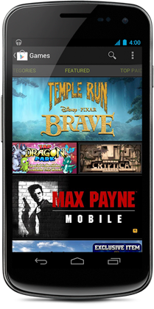
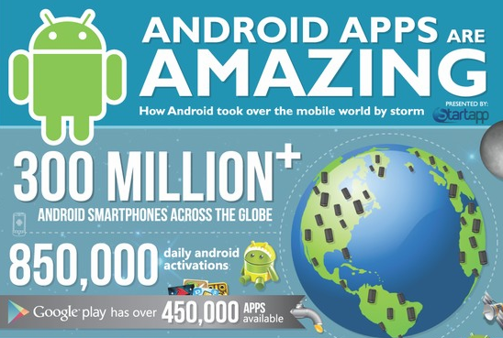
Why Android
Open Marketplace for Distribution
1.5 billion downloads a month and growing

Slide 20
Why Android
Technical Advantages
1. Java Programming Language
2. Open Source Platform with less Proprietary Restrictions and more Opportunities of Innovation
3. Development Environment Support in Windows, Mac OSX and Linux
4. No need to pay to start development
5. Low barrier to Market (No app approval procedure and Low fee)
6. Rich and Easy to Integrate Feature Set
7. Easy and Cost-effective Prototyping for Research and Business

Slide 21

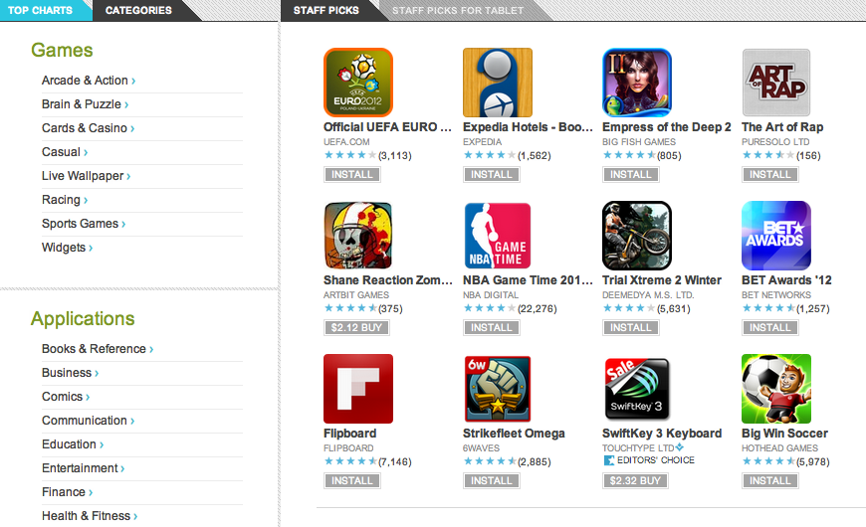
Why Android
http://play.google.com

Slide 22
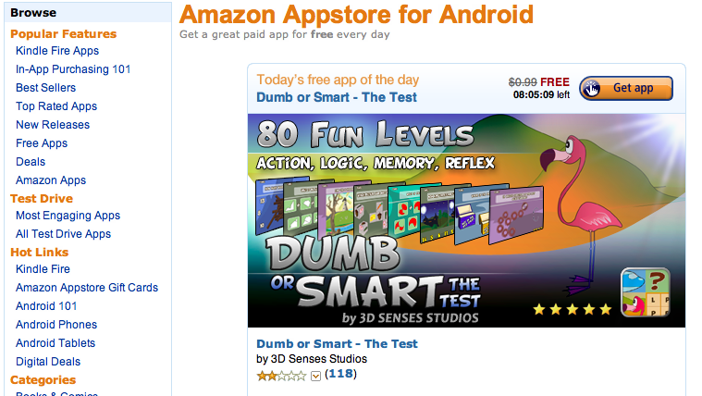
Why Android
Amazon Appstore: http://www.amazon.com/mobile-apps/b/ref=topnav_storetab_mas?ie=UTF8&node=2350149011

Slide 23
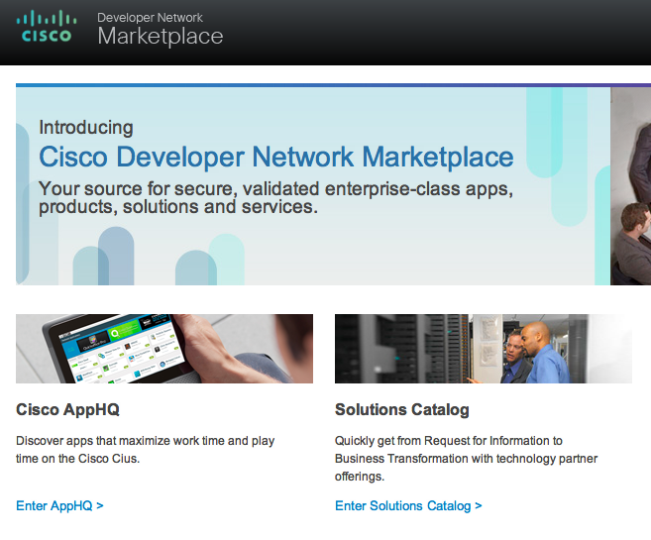
Why Android
Cisco Enterprise Market: https://marketplace.cisco.com/

Slide 24
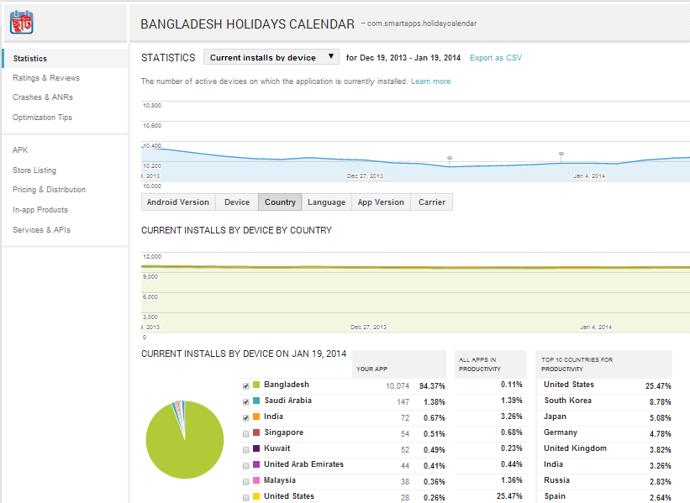
Google Play: Some Awesome Features

Slide 25
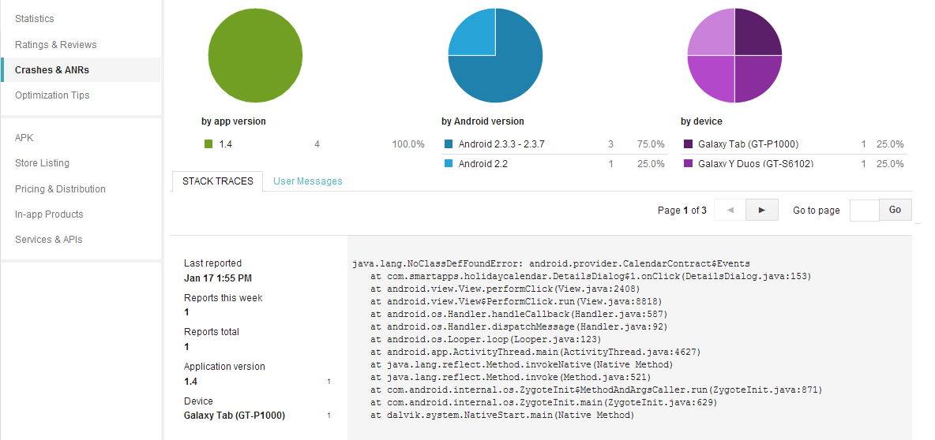
Google Play: Some Awesome Features

Slide 26
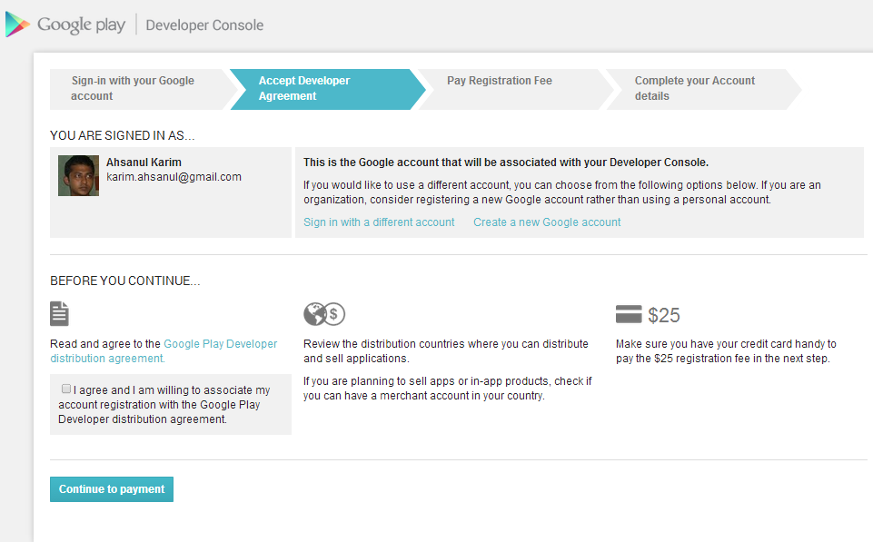
Google Play: Some Awesome Features

Slide 27
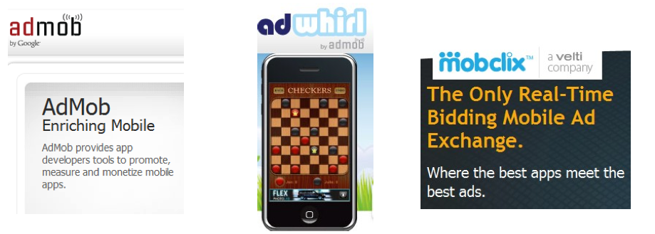
Google Play: Monetization $ $ $ $ $ $
Paid Apps
In-App Billing
Free Apps with Advertisements

Slide 28
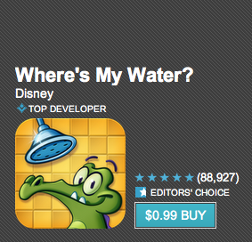
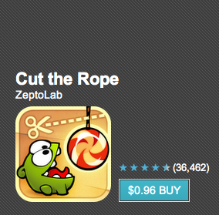
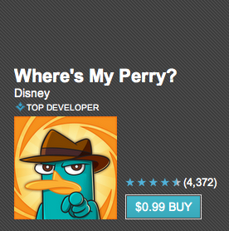
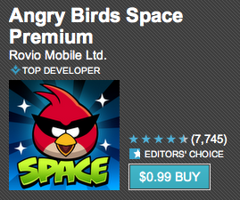
Application Trends
Games
Download Count: 1,000,000-5,000,000
Download Count: 1,000,000-5,000,000
Download Count: 50,000-1,00,000
Download Count: 1,000,000-5,000,000

Slide 29
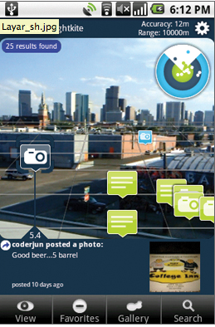
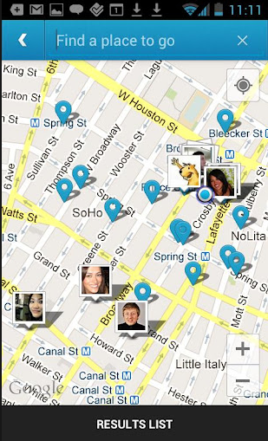
Application Trends
Location Based Services
Gartner expects the total user base of location based services to reach 1.4 Billion by 2014
Will be more intelligent
Will be more context-aware
From: Gartner

Slide 30


Application Trends
Mobile Social Networking
Fastest growing platform
Videos
Photos
Games
Commerce
Marketing
From: Gartner

Slide 31
Application Trends
Mobile Search
Mobile Payments
Context Aware Service
Object Recognition
Mobile Instant Messaging
Mobile Email
Mobile Video
From: Gartner

Slide 32
What is Android
The first truly open and comprehensive platform for mobile devices. It includes an operating system, user-interface and applications — all of the software to run a mobile phone but without the proprietary obstacles that have hindered mobile innovation.
—Where’s My Gphone?
http://googleblog.blogspot.com/2007/11/ wheres-my-gphone.html

Slide 33
What is Android
Android is an ecosystem made up of a combination of three components:
A free, open-source operating system for embedded devices
An open-source development platform for creating applications
Devices, particularly mobile phones, that run the Android operating system and the applications created for it

Slide 34
Android SDK Features
More specifically, Android is made up of several necessary and dependent parts, including the following:
A Compatibility Definition Document (CDD) and Compatibility Test Suite (CTS) that describe the capabilities required for a device to support the software stack.
A Linux operating system kernel
Open source libraries including SQLite, WebKit, OpenGL and Media Manager
A run time used to execute and host Android applications, including the Dalvik Virtual Machine (VM)
An application framework
A user interface framework
A set of core pre-installed applications
A software development kit (SDK) used to create applications, including the related tools, plugins, and documentation

Slide 35
Android SDK Features
Access to Hardware, including Camera, GPS and Sensors
Data Transfers using Wi-Fi, Bluetooth and NFC
Maps, Geocoding and Location Based Services
Background Services
SQLite Database
Shared Data and Inter-Application Communication
Full Multimedia Hardware control including Playback and Recording
GSM, EDGE, 3G, 4G and LTE networks support for Telephony and Data Transfer
Integrated HTML5 supported WebKit based Browser
2D and 3D Graphics using OpenGL ES 2.0

Slide 36

Android SDK Features

Slide 37
Resources
Resource | Link
Book | The Busy Coder's Guide to Android Development [Mark Murphy] Professional Android 4 App Development [Reto Meier]
Blog | http://droidtraining.wordpress.com http://androidstream.wordpress.net
Videos | http://vimeo.com/search?q=androidstream
Training | http://developer.android.com/training/index.html
Slides | http://www.slideshare.net/androidstream/presentations

Slide 38

Thank You
Questions
Sources:
http://developer.android.com
Profession Android 4 Application Development by Reto Meier
Various Websites

